Slide 1


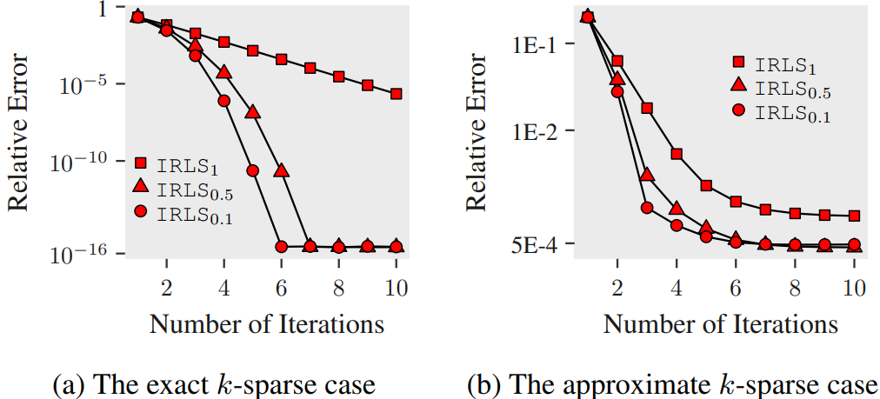
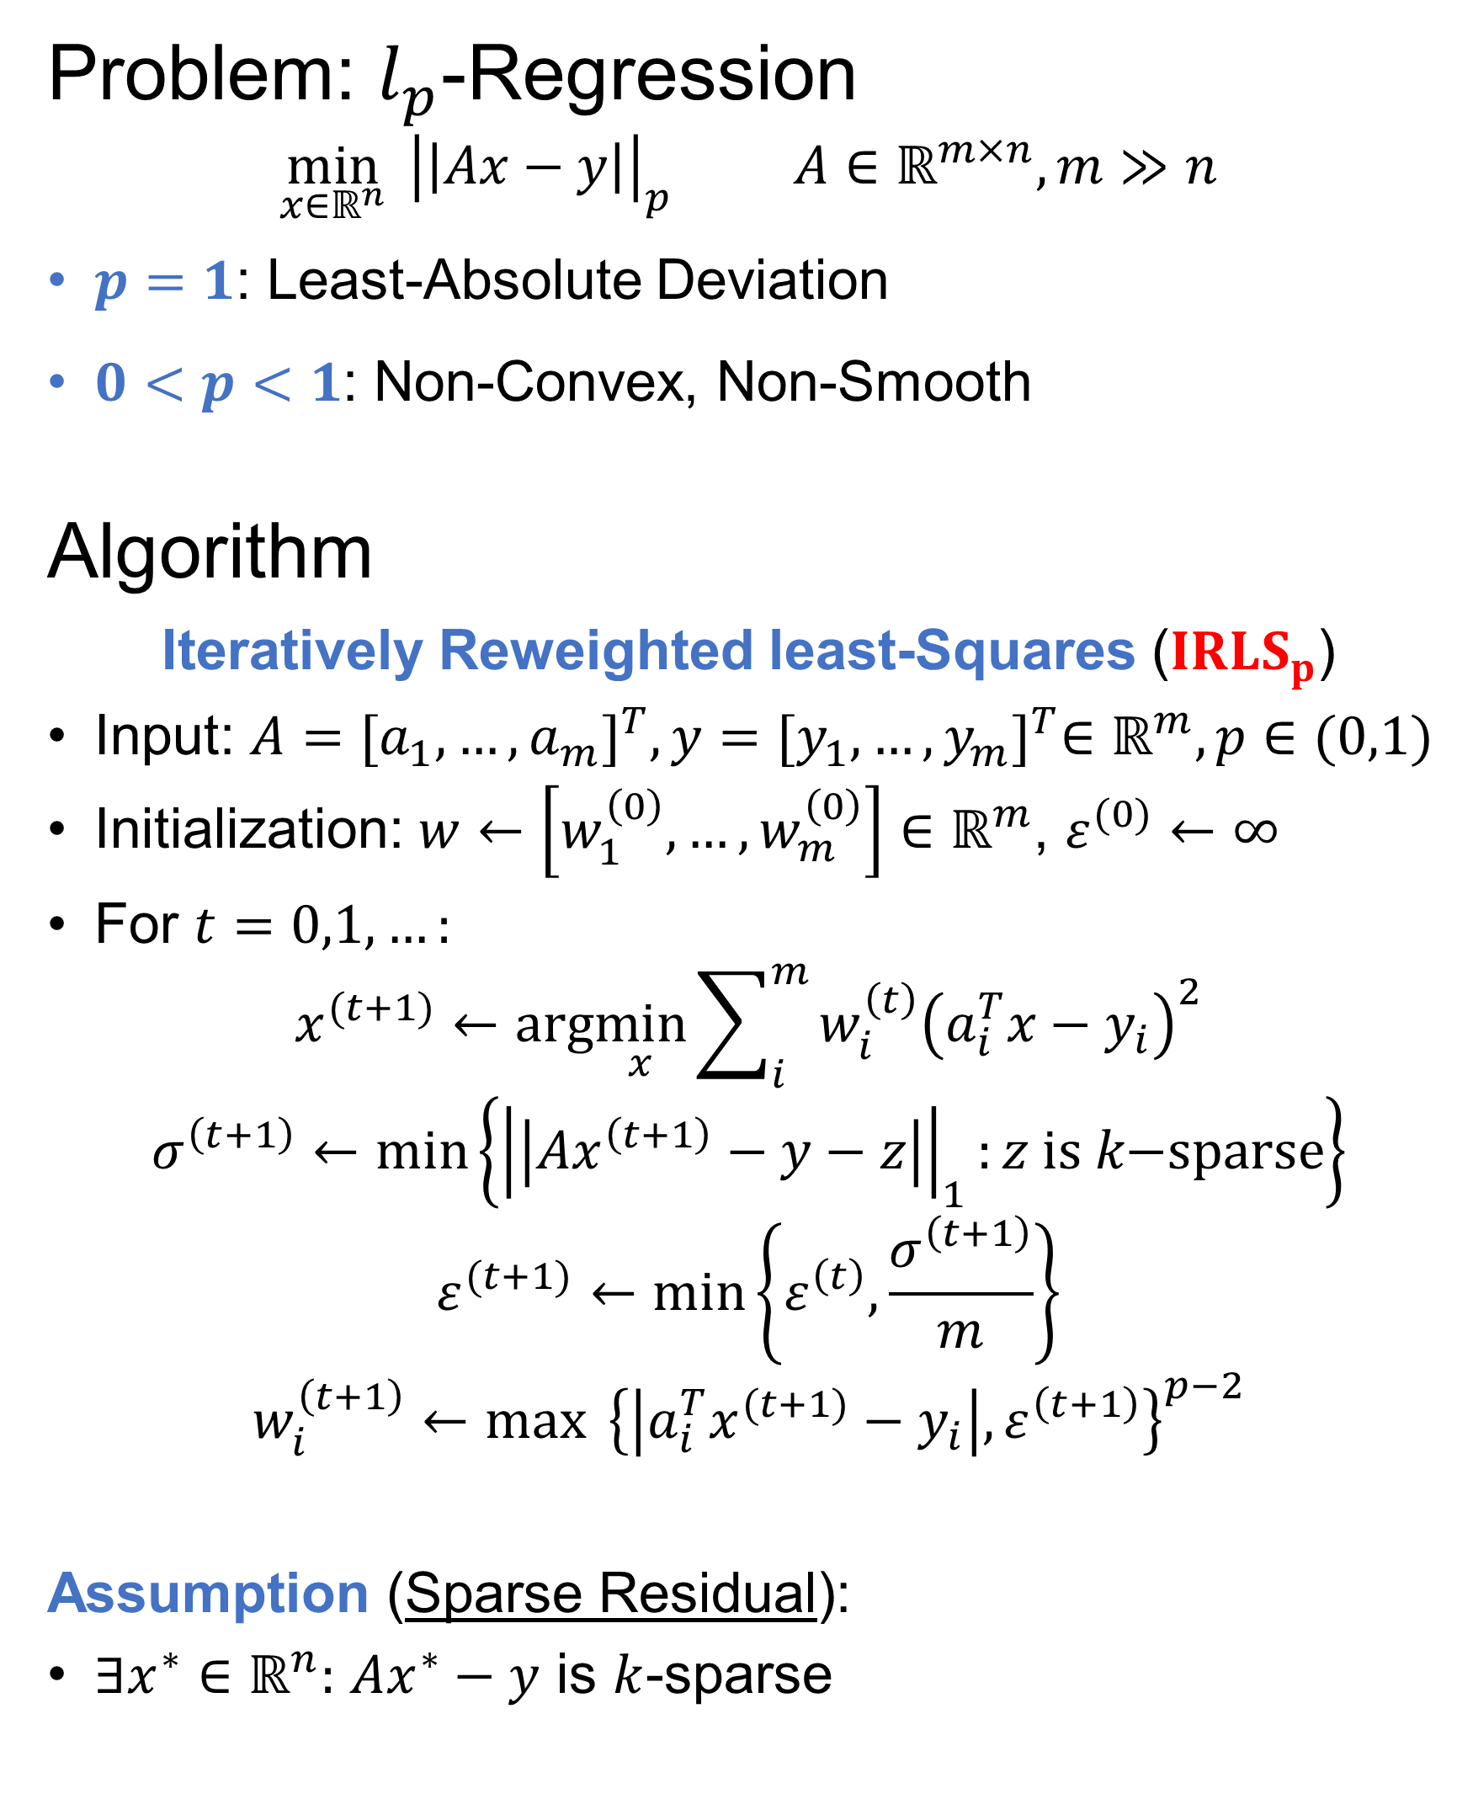
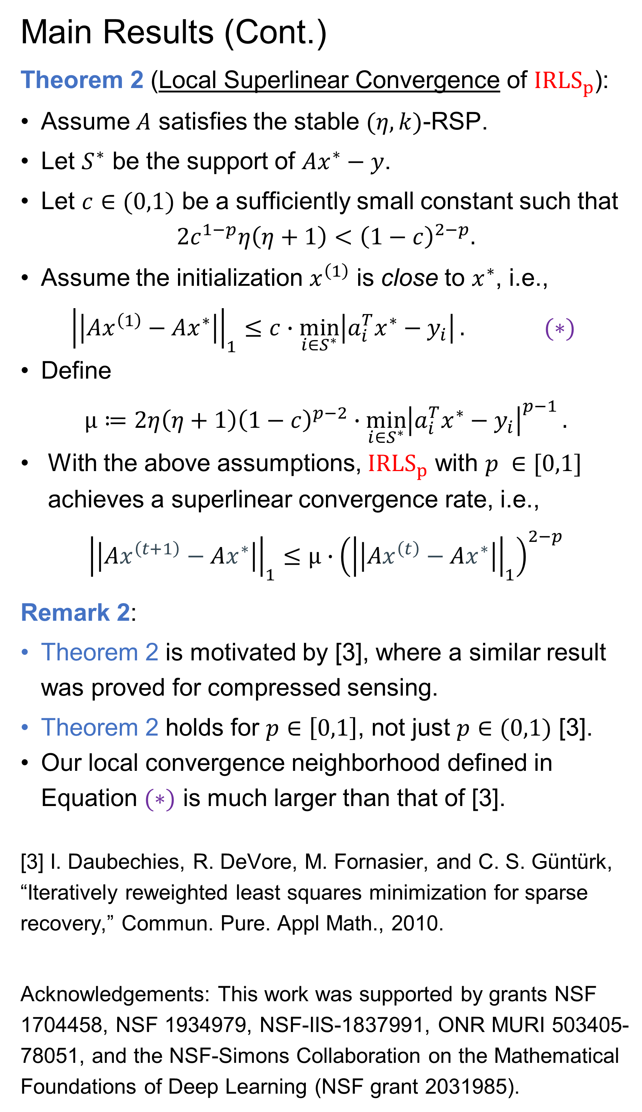
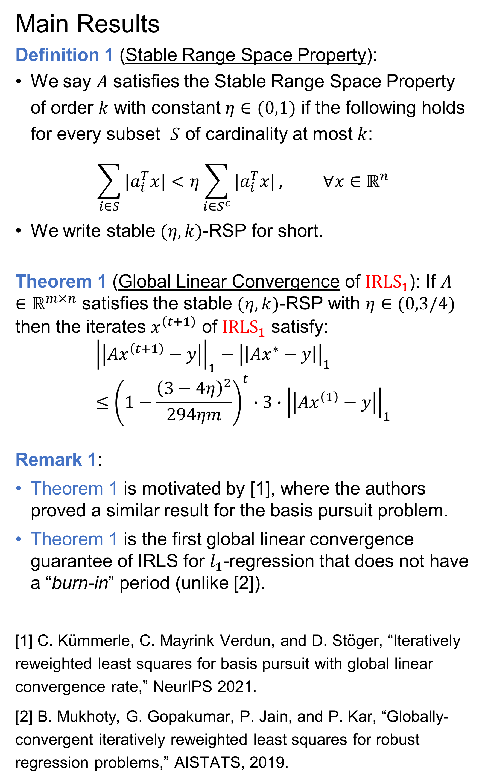
Global Linear and Local Superlinear Convergence of IRLS for Non-Smooth Robust Regression
Liangzu Peng¹ Christian Kümmerle² René Vidal¹
¹Johns Hopkins University ²University of North Carolina, Charlotte
Problem: $l_{p}$-Regression
$$\min_{x∈ℝ^{n}}{{ \left|\left|Ax−y\right|\right|}_{p}} A∈ℝ^{m×n}, m≫n$$
$p=1$: Least-Absolute Deviation
$0<p<1$: Non-Convex, Non-Smooth
Algorithm
Iteratively Reweighted least-Squares (${IRLS}_{p}$)
Input: $A={[a_{1},…,a_{m}]}^{T},y={[y_{1},…,y_{m}]}^{T}∈ℝ^{m},p∈(0,1)$
Initialization: $w←\left[w_{1}^{\left(0\right)},…,w_{m}^{\left(0\right)}\right]∈ℝ^{m}$, $ε^{(0)}←∞$
For $t=0,1,…:$
$$x^{(t+1)}←arg\min_{x}{\sum_{i}^{m}{w_{i}^{\left(t\right)}{\left(a_{i}^{T}x−y_{i}\right)}^{2}}}$$
$$σ^{\left(t+1\right)}←\min\left\{{\left|\left|Ax^{\left(t+1\right)}−y−z\right|\right|}_{1}:z is k\text{−}sparse\right\}$$
$$ε^{(t+1)}←\min\left\{ε^{\left(t\right)},\frac{σ^{\left(t+1\right)}}{m}\right\}$$
$$w_{i}^{\left(t+1\right)}←\max_{}{{ \left\{\left|a_{i}^{T}x^{(t+1)}−y_{i}\right|,ε^{\left(t+1\right)}\right\}}^{p−2}}$$
Assumption (Sparse Residual):
$∃x^{∗}∈ℝ^{n}:$ $Ax^{∗}−y$ is $k$-sparse
Main Results
Definition 1 (Stable Range Space Property):
We say $A$ satisfies the Stable Range Space Property of order $k$ with constant $η∈(0,1)$ if the following holds for every subset $S$ of cardinality at most $k$:
$$\sum_{i∈S}{|a_{i}^{T}x|}<η\sum_{i∈S^{c}}{|a_{i}^{T}x|}, ∀x∈ℝ^{n}$$
We write stable $(η,k)$-RSP for short.
Theorem 1 (Global Linear Convergence of ${IRLS}_{1}$): If $A∈ℝ^{m×n}$ satisfies the stable $(η,k)$-RSP with $η∈(0,3/4)$ then the iterates $x^{\left(t+1\right)}$ of ${IRLS}_{1}$ satisfy:
$${\left|\left|Ax^{\left(t+1\right)}−y\right|\right|}_{1}−{\left|\left|Ax^{∗}−y\right|\right|}_{1}≤{\left(1−\frac{{\left(3−4η\right)}^{2}}{294ηm}\right)}^{t}∙3∙{\left|\left|Ax^{\left(1\right)}−y\right|\right|}_{1}$$
Remark 1:
Theorem 1 is motivated by [1], where the authors proved a similar result for the basis pursuit problem.
Theorem 1 is the first global linear convergence guarantee of IRLS for $l_{1}$-regression that does not have a “burn-in” period (unlike [2]).
[1] C. Kümmerle, C. Mayrink Verdun, and D. Stöger, “Iteratively reweighted least squares for basis pursuit with global linear convergence rate,” NeurIPS 2021.
[2] B. Mukhoty, G. Gopakumar, P. Jain, and P. Kar, “Globally-convergent iteratively reweighted least squares for robust regression problems,” AISTATS, 2019.
Main Results (Cont.)
Theorem 2 (Local Superlinear Convergence of ${IRLS}_{p}$):
Assume $A$ satisfies the stable $(η,k)$-RSP.
Let $S^{∗}$ be the support of $Ax^{∗}−y$.
Let $c∈(0,1)$ be a sufficiently small constant such that
$$2c^{1−p}η\left(η+1\right)<{\left(1−c\right)}^{2−p}.$$
Assume the initialization $x^{\left(1\right)}$ is close to $x^{∗}$, i.e.,
$${\left|\left|Ax^{\left(1\right)}−Ax^{∗}\right|\right|}_{1}≤c∙\min_{i∈S^{∗}}\left|a_{i}^{T}x^{∗}−y_{i}\right|. (∗)$$
Define
$$μ≔2η\left(η+1\right){\left(1−c\right)}^{p−2}∙\min_{i∈S^{∗}}{{\left|a_{i}^{T}x^{∗}−y_{i}\right|}^{p−1}}.$$
With the above assumptions, ${IRLS}_{p}$ with $p ∈[0,1]$ achieves a superlinear convergence rate, i.e.,
$${\left|\left|Ax^{\left(t+1\right)}−Ax^{∗}\right|\right|}_{1}≤μ∙{\left({\left|\left|Ax^{\left(t\right)}−Ax^{∗}\right|\right|}_{1}\right)}^{2−p}$$
Remark 2:
Theorem 2 is motivated by [3], where a similar result was proved for compressed sensing.
Theorem 2 holds for $p∈\left[0,1\right]$, not just $p∈(0,1)$ [3].
Our local convergence neighborhood defined in Equation $(∗)$ is much larger than that of [3].
[3] I. Daubechies, R. DeVore, M. Fornasier, and C. S. Güntürk, “Iteratively reweighted least squares minimization for sparse recovery,” Commun. Pure. Appl Math., 2010.
Acknowledgements: This work was supported by grants NSF 1704458, NSF 1934979, NSF-IIS-1837991, ONR MURI 503405-78051, and the NSF-Simons Collaboration on the Mathematical Foundations of Deep Learning (NSF grant 2031985).

